Slide 1
Concurrent Programming in .NET
Jason Bock
Practice Lead

Slide 2
Personal Info
http://www.magenic.com
http://www.jasonbock.net
https://www.twitter.com/jasonbock
https://www.github.com/jasonbock
jasonb@magenic.com

Slide 3
Downloads
https://github.com/JasonBock/Presentations/blob/master/
Concurrent%20Programming%20in%20.NET.pptx
https://github.com/JasonBock/ConcurrentProgramming
https://github.com/JasonBock/ExpressionEvolver

Slide 4
Overview
Background
Recommendations
Remember…
https://github.com/JasonBock/Presentations/blob/master/
Concurrent%20Programming%20in%20.NET.pptx
https://github.com/JasonBock/ConcurrentProgramming
https://github.com/JasonBock/ExpressionEvolver

Slide 5

Background
http://www.2112.net/powerwindows/downloads/smartphone960x854/Rush-HoldYourFire2.jpg
Notes:
Writing concurrent applications safely feels like juggling balls of fire. Even with modern techniques, it’s still something you have to think about carefully.

Slide 6
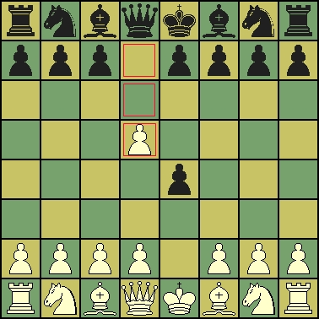
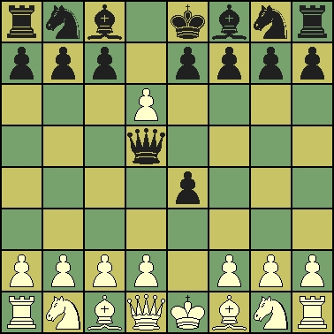
Background
http://www.jasonbock.net/Article/ConcurrentChess
Notes:
Lots of processes that we do have been traditionally thought of as sequential. But what happens if we make things, like games, happen the way our universe works: concurrently?
(Side note: people may look at the starting position and wonder how in the world we got there. First move, W to E4 and B to D5. Second move, they try to take each other and move right through each other ☺).

Slide 7

Background
http://1.bp.blogspot.com/-AZNV9I1nBF4/UB6SvKtIR6I/AAAAAAAAAWY/fk8_oWh9JCI/s1600/midvale+school+for+the+gifted.jpg
Notes:
Whatever we do, let’s make it as easy as we can without breaking stuff badly or making performance tank.

Slide 8

Background
Parallelism
https://www.quora.com/What-are-the-differences-between-parallel-concurrent-and-asynchronous-programming
Notes:
But first, a comparison of asynchronous, parallel and concurrent work.
“Parallel programs distribute their tasks to multiple processors, that actively work on all of them simultaneously.”

Slide 9

Background
Concurrency
https://www.quora.com/What-are-the-differences-between-parallel-concurrent-and-asynchronous-programming
Notes:
“Concurrent programs handle tasks that are all in progress at the same time, but it is only necessary to work briefly and separately on each task, so the work can be interleaved in whatever order the tasks require.”

Slide 10

Background
Asynchronous
https://www.quora.com/What-are-the-differences-between-parallel-concurrent-and-asynchronous-programming
Notes:
“An asynchronous program dispatches tasks to devices that can take care of themselves, leaving the program free do something else until it receives a signal that the results are finished.”

Slide 11
Recommendations
Avoid direct usage of Thread and ThreadPool
Understand async/await/Task
Use locks wisely
Use concurrent and immutable data structures
Let someone else worry about concurrency (actors)

Slide 12

Recommendations – Threads and ThreadPool
http://www.ikea.com/us/en/images/products/sy-sewing-thread__63544_PE171202_S4.JPG
Notes:
First off, STOP creating threads explicitly! But why?

Slide 13
Recommendations – Threads and ThreadPool
Job
Thread
Process
Fiber
Notes:
A brief primer. Most people think of programs in Windows as being processes and threads. There are also jobs and fibers, but they’re rarely if ever used.

Slide 14
Recommendations – Threads and ThreadPool
class Program
{
static void Main(string[] args)
{
var threads = new Thread[64];
for(var i = 0; i < threads.Length; i++)
{
threads[i] = new Thread(Program.DoThreading);
threads[i].Start();
}
foreach(var thread in threads)
{
thread.Join();
}
}
private static void DoThreading() =>
Console.Out.WriteLine($"Current thread ID: {Thread.CurrentThread.ManagedThreadId}");
}
Cores
Stack size
Notes:
You can easily create threads, but there’s two problems here: the stack size and the optimum number of threads.

Slide 15
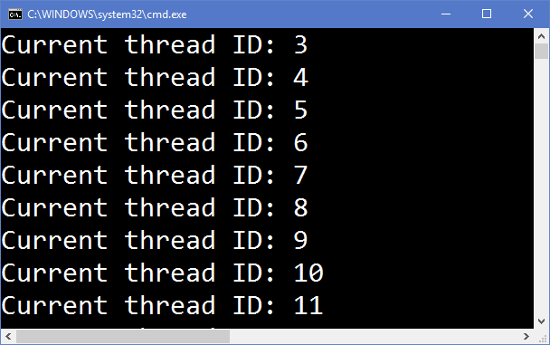
Recommendations – Threads and ThreadPool
Notes:
You can easily create threads, but there’s two problems here: the stack size and the optimum number of threads.

Slide 16

Recommendations – Threads and ThreadPool
http://www.timing-architects.com/wp-content/uploads/2011/02/MultiCPU_small.jpg
Notes:
One is create the “right” amount of threads, which should be equal to the number of cores.

Slide 17
Recommendations – Threads and ThreadPool
For one core…
Thread 1
Process 1
Thread 2
Process 2
Thread 2
Process 1
Thread 1
Process 1
Notes:
A thread can’t dominate a core. The OS will switch out threads so they can all work as needed. Those little boxes in between are context switches, so you can see that they can add up over time.

Slide 18
Recommendations – Threads and ThreadPool
1 MB
new Thread(…);
1 MB
new Thread(…);
1 MB
new Thread(…);
1 MB
new Thread(…);
Notes:
Also, by default, each thread allocates 1 MB of memory on the stack. If you keep making more, you’ll burn memory. If you don’t reuse them, that’s a lot of memory to keep re-allocating.

Slide 19
Recommendations – Threads and ThreadPool
private static void CreateNewThreadsViaPool()
{
for(var i = 0; i < 64; i++)
{
ThreadPool.QueueUserWorkItem(
Program.DoThreadingWithData, i);
}
}
private static void DoThreadingWithData(object id) =>
Console.Out.WriteLine(
$"Current id: {id}, thread ID: {Thread.CurrentThread.ManagedThreadId}");
?
Notes:
Using the ThreadPool allows threads to be shared/pooled, so you’re not creating actual new threads in .NET. However, note that there is only one object that can be passed to WaitCallback. If you want to pass wait mechanisms to the thread, you have to create a custom object to pass it or share it outside of the method execution.

Slide 20
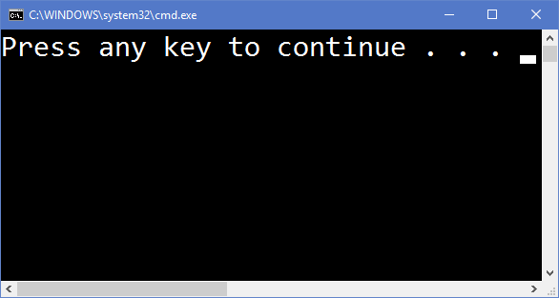
Recommendations – Threads and ThreadPool
Notes:
Otherwise, you’ll get output like this.

Slide 21
Recommendations – Threads and ThreadPool
private static void CreateNewThreadsViaPoolAndWait()
{
var waits = new EventWaitHandle[64];
for (var i = 0; i < 64; i++)
{
var wait = new ManualResetEvent(false);
waits[i] = wait;
ThreadPool.QueueUserWorkItem(
Program.DoThreadingWithThreadingData, new ThreadingData(wait, i));
}
WaitHandle.WaitAll(waits);
}
private static void DoThreadingWithThreadingData(object data)
{
var value = data as ThreadingData;
Console.Out.WriteLine(
$"Current id: {value.Id}, thread ID: {Thread.CurrentThread.ManagedThreadId}");
value.Wait.Set();
}
Notes:
Here’s one way you can communicate across threads. As you’ll see later, using async/await/Tasks is much easier.

Slide 22
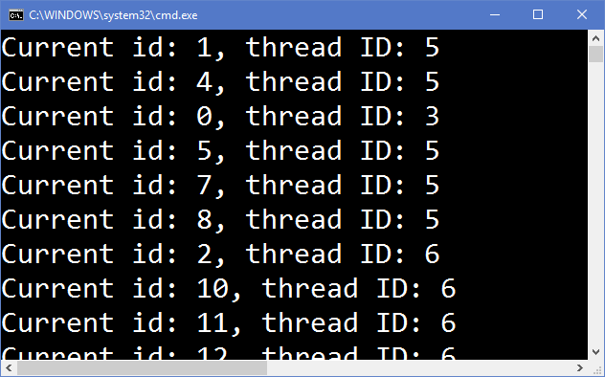
Recommendations – Threads and ThreadPool
Notes:
Note that now we can see threads being reused.

Slide 23
Recommendations – Async/Await/Tasks
Asynchronous Programming Model (APM)
Event-based Asynchronous Pattern (EAP)
Task-based Asynchronous Pattern (TAP)
https://docs.microsoft.com/en-us/dotnet/standard/asynchronous-programming-patterns/
Notes:
Over the years different APMs showed up in .NET, but now we have Task, the primary abstraction.
APM: An asynchronous operation that uses the IAsyncResult design pattern is implemented as two methods named Begin OperationName and End OperationName that begin and end the asynchronous operation OperationName respectively. For example, the FileStream class provides the BeginRead and EndRead methods to asynchronously read bytes from a file. These methods implement the asynchronous version of the Read method.
EAP: A class that supports the Event-based Asynchronous Pattern will have one or more methods named MethodNameAsync. These methods may mirror synchronous versions, which perform the same operation on the current thread. The class may also have a MethodNameCompleted event and it may have a MethodNameAsyncCancel (or simply CancelAsync) method.
TAP: TAP uses a single method to represent the initiation and completion of an asynchronous operation. This is in contrast to the Asynchronous Programming Model (APM or IAsyncResult) pattern, which requires Begin and End methods, and in contrast to the Event-based Asynchronous Pattern (EAP), which requires a method that has the Async suffix and also requires one or more events, event handler delegate types, and EventArg-derived types. Asynchronous methods in TAP include the Async suffix after the operation name; for example, GetAsync for a get operation. If you're adding a TAP method to a class that already contains that method name with the Async suffix, use the suffix TaskAsync instead. For example, if the class already has a GetAsync method, use the name GetTaskAsync.

Slide 24
Recommendations – Async/Await/Tasks
class Program
{
static void Main(string[] args)
{
Console.Out.WriteLine(
$"Main thread id: {Thread.CurrentThread.ManagedThreadId}");
AsyncContext.Run(() => Program.MainAsync(args));
}
private static async Task MainAsync(string[] args)
{
Console.Out.WriteLine(
$"MainAsync thread id: {Thread.CurrentThread.ManagedThreadId}");
await Program.ReadFileAsync();
}
Notes:
Let’s see how async/await with Tasks work

Slide 25
Recommendations – Async/Await/Tasks
private static async Task ReadFileAsync()
{
await Console.Out.WriteLineAsync($"ReadFileAsync thread id: {Thread.CurrentThread.ManagedThreadId}");
using (var stream = new StreamReader("lines.txt"))
{
while (!stream.EndOfStream)
{
var line = await stream.ReadLineAsync();
await Console.Out.WriteLineAsync(
$"ReadFileAsync - after ReadLineAsync(), thread id: {Thread.CurrentThread.ManagedThreadId}");
await Console.Out.WriteLineAsync(line);
await Console.Out.WriteLineAsync(
$"ReadFileAsync - after WriteLineAsync(), thread id: {Thread.CurrentThread.ManagedThreadId}");
}
}
}
}
Notes:
Let’s see how async/await with Tasks work

Slide 26
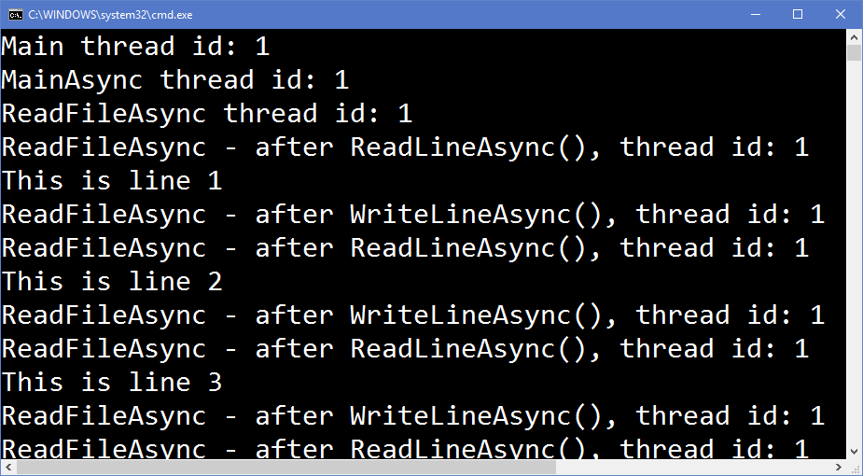
Recommendations – Async/Await/Tasks
Notes:
When I run this, the thread ID never changes. But….everything is async, right? That’s not what async/await do.

Slide 27
Recommendations – Async/Await/Tasks
1
using (var stream = new StreamReader("lines.txt"))
{
while (!stream.EndOfStream)
{
var line = await stream.ReadLineAsync();
await Console.Out.WriteLineAsync(
$"ReadFileAsync - after ReadLineAsync(), thread id: {Thread.CurrentThread.ManagedThreadId}");
2
3
IOCP
Notes:
Step 1: Create the object. Straightforward.
Step 2: Await ReadLineAsync(). That goes to a IOCP
Step 3: Await WriteLineAsync(). That goes to a ICOP….or does it?

Slide 28
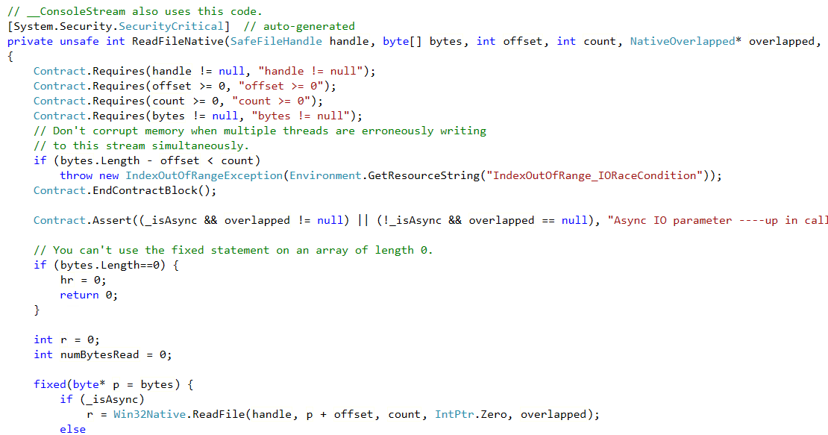
Recommendations – Async/Await/Tasks
http://referencesource.microsoft.com/#mscorlib/system/io/filestream.cs,c927d44953cf2ac4
Notes:
This is a snippet of code from FileStream. You can see that NativeOverlapped is used when “_isAsync” is true. It’s complex for sure, but this is definitely what goes on at the end of the day.

Slide 29
Recommendations – Async/Await/Tasks
Block
Block
Method1()
Method1()
Method1()
Method2()
Notes:
The beauty of doing true async I/O work is that a thread can (potentially) share multiple workloads. If you block, you’re forced to spin up more threads, which doesn’t help with scalability.

Slide 30
Recommendations – Async/Await/Tasks
Non-Blocking
Non-Blocking
Method1()
Method1()
Method1()
Method2()
Notes:
The beauty of doing true async I/O work is that a thread can (potentially) share multiple workloads. If you block, you’re forced to spin up more threads, which doesn’t help with scalability.

Slide 31
Recommendations – Async/Await/Tasks
[AsyncStateMachine(typeof(Program.<ReadFileAsync>d__2))]
private static Task ReadFileAsync()
{
Program.<ReadFileAsync>d__2 <ReadFileAsync>d__;
<ReadFileAsync>d__.<>t__builder = AsyncTaskMethodBuilder.Create();
<ReadFileAsync>d__.<>1__state = -1;
AsyncTaskMethodBuilder <>t__builder = <ReadFileAsync>d__.<>t__builder;
<>t__builder.Start<Program.<ReadFileAsync>d__2>(ref <ReadFileAsync>d__);
return <ReadFileAsync>d__.<>t__builder.Task;
}
Notes:
That’s what ReadFileAsync really looks like!
Let’s focus on two things. The Start() call initiates a state machine defined by <ReadFileAsync>d__2

Slide 32
Recommendations – Async/Await/Tasks
[CompilerGenerated]
[StructLayout(LayoutKind.Auto)]
private struct <ReadFileAsync>d__2 : IAsyncStateMachine
{
IL_2A5:
if (!this.<stream>5__1.EndOfStream)
{
taskAwaiter2 = this.<stream>5__1.ReadLineAsync().GetAwaiter();
if (!taskAwaiter2.IsCompleted)
{
Notes:
That’s a class that implements a state machine. Even from a relatively simple piece of code, the state machine can get quite complex to follow. But notice that async invocations will always check the IsCompleted value of the returned Task first. Therefore, if your async method has a “fast path” to be complete right away….

Slide 33
Recommendations – Async/Await/Tasks
[HostProtectionAttribute(SecurityAction.LinkDemand, Synchronization = true,
ExternalThreading = true)]
public class Task : IAsyncResult, IDisposable
var code1 = Task.Run(() => { ... });
var code2 = Task.Run(() => { ... });
var code3 = Task.Run(() => { ... });
await Task.WhenAll(code1, code2, code3);
Notes:
By the way, what IS a Task? It “represents an asynchronous operation”, though keep in mind it can also be used to spawn new Task instances via Task.Run

Slide 34
Recommendations – Async/Await/Tasks
public async void DoSomething()
{
...
}
Notes:
Now you can see why you should never do “async void”, because there’s nothing the compiler can do with an async method that doesn’t return a task. How do you “continue with” the next piece of code? The ONLY time this is acceptable is with event handlers in XAML apps.

Slide 35
Recommendations – Async/Await/Tasks
[Serializable]
internal sealed class SyncTextWriter : TextWriter, IDisposable
{
...
[MethodImplAttribute(MethodImplOptions.Synchronized)]
[ComVisible(false)]
public override Task WriteLineAsync(String value)
{
WriteLine(value);
return Task.CompletedTask;
}
http://referencesource.microsoft.com/#mscorlib/system/io/textwriter.cs,8ca1636fb9d6531f
Notes:
You should give a fair amount of consideration to introducing asynchronous operations in base types. If the type doesn’t want to enforce it, it can return Task.FromResult or Task.CompletedTask, but this will probably still end up with an async state machine compiled in code.

Slide 36
Recommendations – Async/Await/Tasks
[Synchronous]
public override Task<int> DoSomething()
{
return Task.FromResult(22);
}
...
var result = x.DoSomething().Result;
var resultAwait = await x.DoSomething() // wrong!
http://referencesource.microsoft.com/#mscorlib/system/io/textwriter.cs,8ca1636fb9d6531f
Notes:
Side note: adding MethodImplOptions.Synchronized doesn’t mean the method will not be called without the async machine. Someday I’ll create this attribute with the analyzer and make sure people don’t call it with await; they can simply invoke it and potentially call .Result on it without blocking issues.

Slide 37
Demo: Evolving Expressions
Concurrent Programming in .NET
Notes:
Let’s look at my ExpressionEvolver application and how I use Tasks to do things concurrently.

Slide 38

Recommendations – Locks
http://www.openseesay.com/wp-content/uploads/2014/07/lock_and_key.jpg
Notes:
First off, avoid locks if you can. Locks are expensive, and may be a sign that you haven’t isolated key functional parts of your application. It isn’t something that you can completely eliminate, but if your code is littered with locking strategies, you’ve got issues.
May want to talk about experiences with locking in applications, like, “I should be the only person able to make changes on this loan.”

Slide 39


Recommendations – Locks
Method1
Method2
Lock1
Lock2
http://www.clker.com/cliparts/4/K/F/C/a/c/skull-and-crossbones-hi.png
Notes:
It’s also very easy to create deadlocks. If two pieces of code acquire a lock and then try to lock on those acquired locks, your code is dead. There are ways to mitigate that, but whenever you do locks, you have to be aware of this.

Slide 40
Recommendations – Locks
public sealed class MonitorLedger
: ILedger
{
private readonly object @lock = new object();
public Ledger(decimal value) => this.Value = value;
public void Credit(decimal value)
{
lock (this.@lock)
{
this.Value -= value;
}
}
Notes:
Here’s the simplest example of using a lock

Slide 41
Recommendations – Locks
var stringLock = "lock";
lock(stringLock) { ... }
var numberLock = 123;
lock(numberLock) { ... }
lock(this) { ... }
lock(typeof(string)) { ... }
Notes:
Note that the thing you’re locking on matters. Don’t do these!
A string lock can accidentally be shared (strings that are the same exact value are shared)
A lock based on a value type are boxed and end up having two different objects being locked on
A “this” lock is not private because others can lock on that object
A “typeof” lock can accidentally be shared if the type is public
These can all lead to unexpected behaviors, potentially deadlocks.

Slide 42
Recommendations – Locks
public sealed class IntegerFieldLedger
{
private int value;
public IntegerFieldLedger(int value) => this.value = value;
public void Credit(int value) =>
Interlocked.Add(ref this.value, value);
public void Debit(int value) =>
Interlocked.Add(ref this.value, value * -1);
public int Value
{
get => this.value;
}
}
Notes:
Depending on the data type you use, you can also use Interlocked, which is much faster than doing locking via Monitor. However, again, you’re limited on specific data types for this to work.

Slide 43
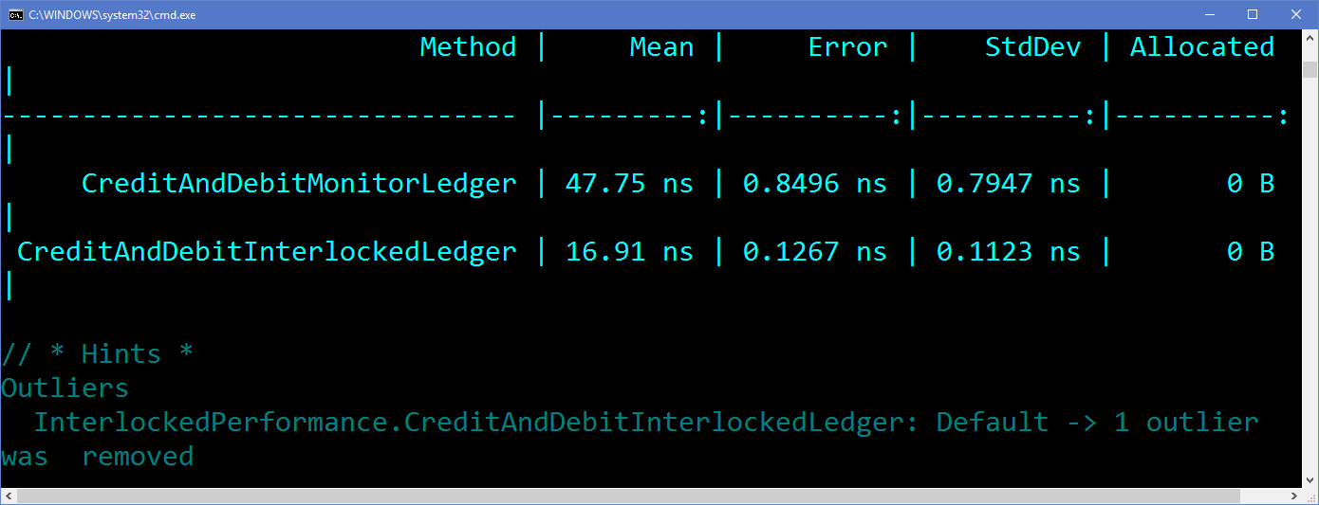
Recommendations – Locks
Notes:
As you can see, it is faster, but it has its limitations.

Slide 44
Recommendations – Locks
public sealed class SpinLockLedger : ILedger
{
private SpinLock @lock = new SpinLock();
public void Credit(decimal value)
{
var isLockAcquired = false;
try
{
this.@lock.Enter(ref isLockAcquired);
this.Value -= value;
}
finally
{
if (isLockAcquired)
{
this.@lock.Exit();
}
}
}
Notes:
You can use another technique to do locking, which is to use a SpinLock

Slide 45
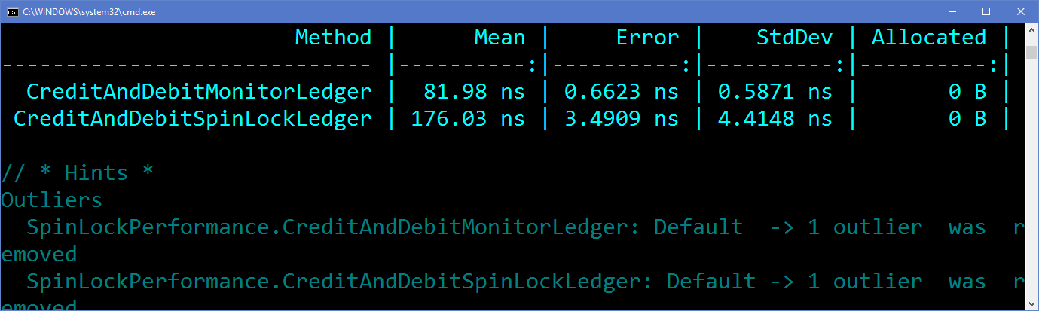
Recommendations – Locks
Notes:
But take care with performance. Make sure it’s worth it.

Slide 46
Recommendations – Locks
In general, while holding a spin lock, one should avoid any of these actions:
Blocking
Calling anything that itself may block
Holding more than one spin lock at once
Making dynamically dispatched calls (interface and virtuals)
Making statically dispatched calls into any code one doesn't own
Allocating memory
https://docs.microsoft.com/en-us/dotnet/api/system.threading.spinlock?view=netframework-4.7
Notes:
Also, read the docs and don’t use a SpinLock if you’re in these scenarios
And don’t store SpinLock instances in readonly fields.

Slide 47
Demo: Benchmarking Code
Concurrent Programming in .NET
Notes:
Let’s look at how you can use Benchmark to diagnose perf issues.

Slide 48
Recommendations – Data Structures
Notes:
Another aspect to keep in mind is the data structures you’re using. In recent times, new data structures have been released that can help in certain concurrent scenarios.

Slide 49
Recommendations – Data Structures
var guidsInStack = new Stack<Guid>();
for (var i = 0; i < 100; i++)
{
guidsInStack.Push(Guid.NewGuid());
}
Console.Out.WriteLine(
$"{nameof(guidsInStack)}.Pop() is {guidsInStack.Pop()}");
Notes:
For example, take a look at this simple code to create a stack.

Slide 50
Recommendations – Data Structures
var guidsInConcurrentStack = new ConcurrentStack<Guid>();
for (var i = 0; i < 100; i++)
{
guidsInConcurrentStack.Push(Guid.NewGuid());
}
if(guidsInConcurrentStack.TryPop(out var concurrentResult))
{
Console.Out.WriteLine(
$"{nameof(guidsInConcurrentStack)}.TryPop() is {concurrentResult}");
}
Notes:
If you want a stack that is thread-safe, then you can use a ConcurrentStack. Note that pulling values out are done slightly different.

Slide 51
Recommendations – Data Structures
var guidsInImmutableStack = ImmutableStack<Guid>.Empty;
for (var i = 0; i < 100; i++)
{
guidsInImmutableStack = guidsInImmutableStack.Push(Guid.NewGuid());
}
guidsInImmutableStack = guidsInImmutableStack.Pop(
out var immutableResult);
Console.Out.WriteLine(
$"{nameof(guidsInImmutableStack)}.Pop() is {immutableResult}");
Notes:
You can also make immutable stacks (think Roslyn syntax trees). Remember to capture return values! Note that the .Pop() SHOULD be captured as well, though in this case we don’t care.

Slide 52
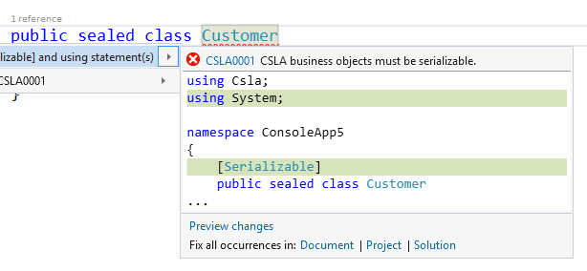
Recommendations – Data Structures
Notes:
And why are immutable structures used by the Compiler API? Many reasons, but this one illustrates it very well. A code fix doesn’t change the code in the code editor; it’s a copy and it’ll only be committed if the developer accepts it.

Slide 53

Recommendations – Actors
http://4.bp.blogspot.com/-UciCVgN_qjc/T8-D3CWVDwI/AAAAAAAAC-s/8PayskM5gvg/s1600/cat00870pi.jpg
Notes:
The best code is the code you don’t write. Nothing can be truer with concurrent programming. If you don’t have to do it and you can be lazy, go for it!

Slide 54
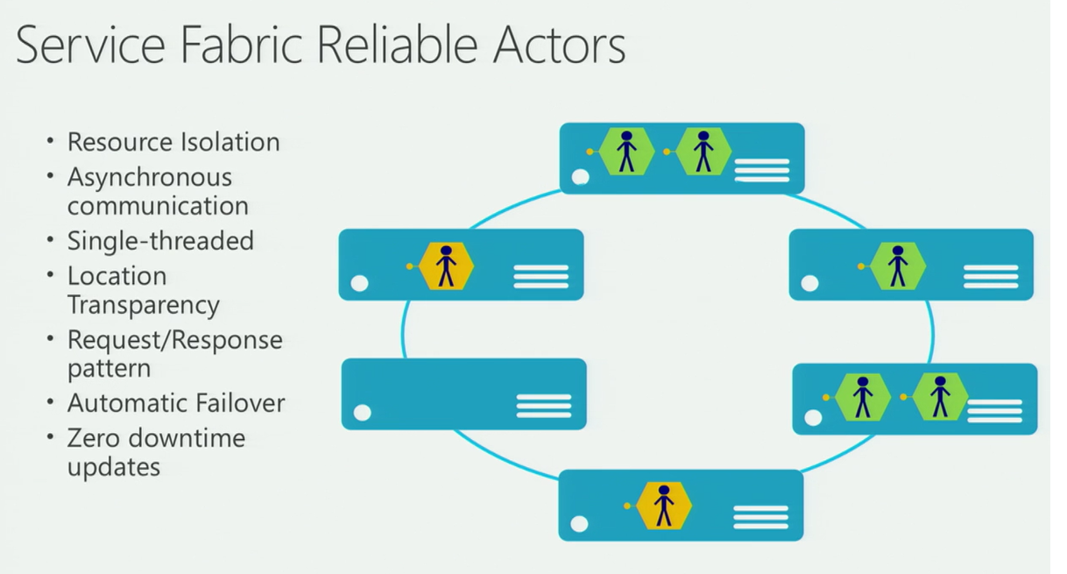
Recommendations – Actors
https://blog.imaginea.com/wp-content/uploads/2016/08/ActorModelAdvantages.png
Notes:
Actor frameworks are great because all of the communication with and between actors are asynchronous, but the message processing itself is synchronous (unless the handler itself is async)

Slide 55
Demo: Using Orleans
Concurrent Programming in .NET
Notes:
Let’s look at how one can use Orleans to handle messages

Slide 56
Concurrent Programming in .NET
Jason Bock
Practice Lead
Remember…
https://github.com/JasonBock/Presentations/blob/master/Concurrent%20Programming%20in%20.NET.pptx
https://github.com/JasonBock/ConcurrentProgramming
https://github.com/JasonBock/ExpressionEvolver
References in the notes on this slide
Notes:
References:
Eric Lipper Async Articles = https://blogs.msdn.microsoft.com/ericlippert/tag/async/;
Stephen Cleary blog - http://blog.stephencleary.com/
Parallel Programming with .NET blog - https://blogs.msdn.microsoft.com/pfxteam/
SpinLock - https://docs.microsoft.com/en-us/dotnet/standard/threading/spinlock
How can I find out how many threads are active in the CLR thread pool? - https://blogs.msdn.microsoft.com/oldnewthing/20170724-00/?p=96675
lock Statement (C# Reference) (Best practices) - https://docs.microsoft.com/en-us/dotnet/csharp/language-reference/keywords/lock-statement
The perils of async void (Deferral objects) - https://blogs.msdn.microsoft.com/oldnewthing/20170721-00/?p=96665
Parallel Processing and Concurrency in the .NET Framework - https://docs.microsoft.com/en-us/dotnet/standard/parallel-processing-and-concurrency
Task-based Asynchronous Pattern (TAP) - https://docs.microsoft.com/en-us/dotnet/standard/asynchronous-programming-patterns/task-based-asynchronous-pattern-tap
Do I need to dispose of Tasks? - https://blogs.msdn.microsoft.com/pfxteam/2012/03/25/do-i-need-to-dispose-of-tasks/
Crash course in async and await - https://blogs.msdn.microsoft.com/oldnewthing/20170720-00/?p=96655
C# Developers: Stop Calling .Result - http://motzcod.es/post/162870742532/c-sharp-developers-stop-calling-dot-result
CallContext in .NET Core - http://www.cazzulino.com/callcontext-netstandard-netcore.html
Async from the Outside, From the inside
Part 1 - https://www.infoq.com/presentations/C-Sharp-Async-From-the-Outside-From-the-Inside
Part 2 - https://www.infoq.com/presentations/C-Sharp-Async-From-the-Outside-From-the-Inside-2
The curious case of async, await, and IDisposable - http://thebillwagner.com/Blog/Item/2017-05-03-ThecuriouscaseofasyncawaitandIDisposable
Maximizing Throughput - The Overhead of 1 Million Tasks - https://www.danielcrabtree.com/blog/248/maximizing-throughput-the-overhead-of-1-million-tasks
The CLR Thread Pool 'Thread Injection' Algorithm - http://mattwarren.org/2017/04/13/The-CLR-Thread-Pool-Thread-Injection-Algorithm/
Common Multithreading Mistakes in C#
Part 1 - http://benbowen.blog/post/cmmics_i/
Part 2 - http://benbowen.blog/post/cmmics_ii/
Part 3 - http://benbowen.blog/post/cmmics_iii/
Part 4 - http://benbowen.blog/post/cmmics_iv/

